Slide 1
Object-Oriented Programming (OOP) in PHP
Your Guide to OOP Development in PHP

Slide 2
What is OOP?

Slide 3
Intro
OOP stands for Object-Oriented Programming.
Procedural programming is about writing procedures or functions that perform operations on the data, while object-oriented programming is about creating objects that contain both data and functions.

Slide 4
OOP has several advantages over PP.
Object-oriented programming has several advantages over procedural programming:
OOP is faster and easier to execute.
OOP provides a clear structure for the programs.
OOP helps to keep the PHP code DRY ("Don't Repeat Yourself") and makes the code easier to maintain, modify, and debug.
OOP makes it possible to create fully reusable applications with less code and shorter development time.

Slide 5
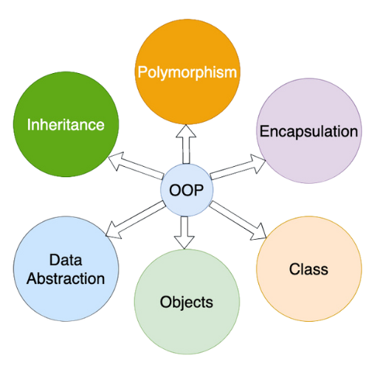
Features of OOP

Slide 6
Types of Cases
Case Type Format Example Typical Use Case
Lowercase myvariable Keywords, file extensions
UPPERCASE CONSTANT_VALUE Constants, environment variables
Camel Case myVariableName Variables, functions
Pascal Case MyClassName Classes, constructors
Snake Case my_variable_name Variables, database columns
Kebab Case my-variable-name CSS classes, HTML IDs
Title Case My Variable Name Titles, headings
Sentence Case This is a sentence. Comments, sentences
Screaming Snake Case MAX_RETRIES_ALLOWED Constants

Slide 7
What are properties and methods?
Variables inside a class that hold data or attributes of objects.
Example: $name, $age.
Functions inside a class that define the behavior or actions of objects.
Example: walk(), calculateTotal().
class Car {
public $brand;
public $speed;
public function displayInfo() {
echo "Brand: $this->brand, Speed: $this->speed km/h";
}
}

Slide 8
What Are Access Modifiers?
Access modifiers define the visibility and accessibility of properties and methods in a class.
Access modifiers define the visibility and accessibility of properties and methods in a class.
Types of Access Modifiers:
Public: Accessible from anywhere. Use for methods or properties that should be accessible universally.
Protected: Accessible within the class and subclasses. Use when the property or method should only be accessible in inheritance.
Private: Accessible only within the class. Use for sensitive data that should remain encapsulated.

Slide 9
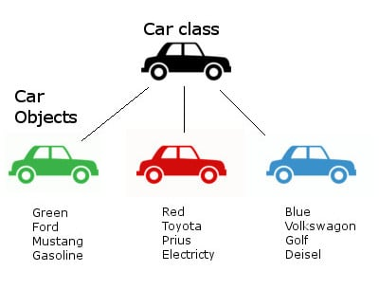
What are classes and objects?
A class is a template for objects, and an object is an instance of a class.
Classes and objects are the two main aspects of object-oriented programming.

Slide 10
What is class?
A class is a template for objects.
A class is defined by using the class keyword, followed by the name of the class and a pair of curly braces ({}). All its properties and methods go inside the braces:
<?php
class Fruit {
// code goes here...
}
?>

Slide 11
What is an object?
an object is an instance of a class.
Classes are nothing without objects! We can create multiple objects from a class. Each object has all the properties and methods defined in the class, but they will have different property values.
Objects of a class are created using the new keyword.
<?php
class Fruit {
// Properties
public $name;
public $color;
// Methods
function set_name($name) {
$this->name = $name;
}
function get_name() {
return $this->name;
}
}
$apple = new Fruit();
$banana = new Fruit();
$apple->set_name('Apple');
$banana->set_name('Banana');
echo $apple->get_name();
echo "<br>";
echo $banana->get_name();
?>

Slide 12
What is inheritance?
A mechanism where one class (child) can derive or inherit the properties and methods of another class (parent). This promotes code reuse and hierarchical classification.
Allows creating specialized classes without rewriting code.
Establishes a relationship between parent and child classes.
<?php
class Fruit {
public $name;
public $color;
public function __construct($name, $color) {
$this->name = $name;
$this->color = $color;
}
public function intro() {
echo "The fruit is {$this->name} and the color is {$this->color}.";
}
}
// Strawberry is inherited from Fruit
class Strawberry extends Fruit {
public function message() {
echo "Am I a fruit or a berry? ";
}
}
$strawberry = new Strawberry("Strawberry", "red");
$strawberry->message();
$strawberry->intro();
?>

Slide 13
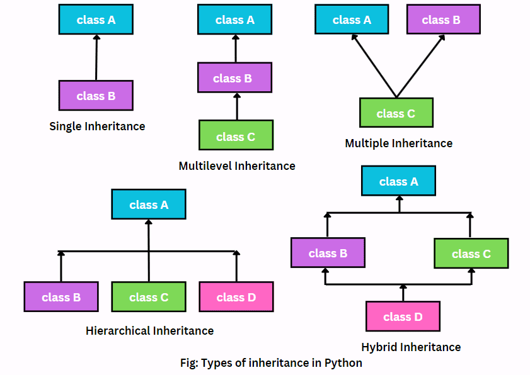
What is inheritance?

Slide 14
Single Inheritance
A single child class inherits from a single parent class.
class ParentClass {
public function greet() {
echo "Hello from Parent!";
}
}
class ChildClass extends ParentClass {
public function welcome() {
echo "Hello from Child!";
}
}
$child = new ChildClass();
$child->greet(); // Output: Hello from Parent!
$child->welcome(); // Output: Hello from Child!

Slide 15
Multilevel Inheritance
A child class inherits from a parent class, and another class inherits from the child class.
class GrandParent {
public function message() {
echo "Message from GrandParent.";
}
}
class ParentClass extends GrandParent {
public function greet() {
echo "Hello from Parent.";
}
}
class ChildClass extends ParentClass {
public function welcome() {
echo "Hello from Child.";
}
}
$child = new ChildClass();
$child->message(); // Output: Message from GrandParent.
$child->greet(); // Output: Hello from Parent.
$child->welcome(); // Output: Hello from Child.

Slide 16
Hierarchical Inheritance
Multiple child classes inherit from a single parent class. When multiple child classes share common functionality from the same parent class.
class ParentClass {
public function greet() {
echo "Hello from Parent!";
}
}
class ChildClass1 extends ParentClass {
public function welcome() {
echo "Hello from Child 1!";
}
}
class ChildClass2 extends ParentClass {
public function welcome() {
echo "Hello from Child 2!";
}
}
$child1 = new ChildClass1();
$child1->greet(); // Output: Hello from Parent!
$child1->welcome(); // Output: Hello from Child 1!
$child2 = new ChildClass2();
$child2->greet(); // Output: Hello from Parent!
$child2->welcome(); // Output: Hello from Child 2!

Slide 17
Hybrid Inheritance
A mix of multiple inheritance types. Direct multiple inheritance is not supported in PHP but can be achieved using interfaces or traits.
trait TraitA {
public function methodA() {
echo "Method from Trait A.";
}
}
trait TraitB {
public function methodB() {
echo "Method from Trait B.";
}
}
class MyClass {
use TraitA, TraitB;
}
$obj = new MyClass();
$obj->methodA(); // Output: Method from Trait A.
$obj->methodB(); // Output: Method from Trait B.

Slide 18
What is polymorphism?
The ability of different classes to define methods with the same name but potentially different implementations.
Promotes flexibility and extensibility in code.
Often achieved through method overriding or interface implementation.
class Car {
public $color; // Property
public $model;
// Constructor Method
public function __construct($color, $model) {
$this->color = $color;
$this->model = $model;
}
// Method
public function start() {
echo "The $this->model car is starting.";
}
}
// Creating an object of the class
$myCar = new Car("Red", "Toyota");
$myCar->start(); // Output: The Toyota car is starting.

Slide 19
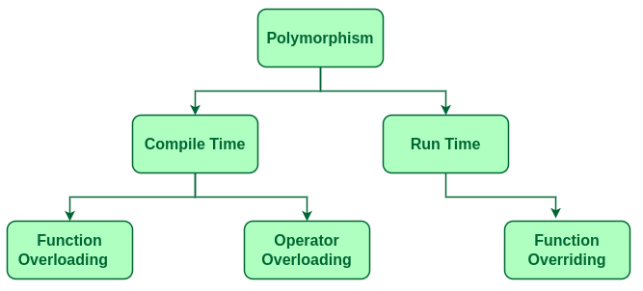
What is polymorphism?

Slide 20
Types of Polymorphism
Compile-Time Polymorphism (Static Polymorphism)
Occurs during the compilation phase.
Achieved through:
Function Overloading: Defining multiple functions with the same name but different parameter types or numbers.
Operator Overloading: Defining custom behavior for operators like +, -, or * for user-defined types.

Slide 21
Function Overloading
Function overloading refers to defining multiple functions with the same name but different sets of parameters (either in type or number). It allows one function to perform different tasks based on how it is called.
It can be simulated using:
Default Parameters
Variable-Length Argument Lists (func_get_args() or ...$args)
Magic Methods (__call)
class MathOperations {
public function add($a, $b) {
return $a + $b;
}
public function addThree($a, $b, $c) {
return $a + $b + $c;
}
}
$math = new MathOperations();
echo $math->add(3, 4);
// Outputs: 7
echo $math->addThree(3, 4, 5);
// Outputs: 12

Slide 22
Function Overloading
Operator Overloading
<?php
class Complex {
public:
int real, imag;
Complex(int r, int i) : real(r), imag(i) {}
Complex operator + (const Complex &obj) {
return Complex(real + obj.real, imag + obj.imag);
}
};
Complex c1(3, 4), c2(1, 2);
Complex result = c1 + c2; // Operator '+' overloaded
?>

Slide 23
Function Overloading
Function Overloading with Default Parameters
class Calculator {
public function add($a, $b, $c = 0) {
return $a + $b + $c; // Adds 2 or 3 numbers
}
}
$calc = new Calculator();
echo $calc->add(2, 3); // Output: 5 (adds 2 numbers)
echo $calc->add(2, 3, 4); // Output: 9 (adds 3 numbers)
Function Overloading with Variable-Length Arguments
class MathOperations {
public function add(...$numbers) {
return array_sum($numbers); // Adds all provided numbers
}
}
$math = new MathOperations();
echo $math->add(1, 2); // Output: 3
echo $math->add(1, 2, 3, 4, 5); // Output: 15

Slide 24
Runtime Polymorphism
2. Runtime polymorphism refers to the ability of a program to resolve method calls at runtime (rather than compile time). It is achieved through method overriding in object-oriented programming.
A child class provides its specific implementation for a method that is already defined in its parent class.
Occurs during the execution phase.
Achieved through:
Function Overriding: A child class redefines a method of its parent class with the same name, parameters, and return type.
Utilizes concepts like inheritance and virtual functions.
Features of Run-Time Polymorphism in PHP:
Inheritance: A child class can inherit and override methods from its parent class.
Interface Implementation: Multiple classes can implement the same interface but provide different implementations for its methods.

Slide 25
Runtime Polymorphism
<?php
class Animal {
public function makeSound() {
echo "Some generic sound";
}
}
class Dog extends Animal {
public function makeSound() {
echo "Bark";
}
}
$animal = new Animal();
$dog = new Dog();
$animal->makeSound();
$dog->makeSound();
?>

Slide 26
What is method overriding?
Method overriding occurs when a subclass provides its own implementation for a method already defined in its parent class. The overridden method in the child class should have the same name, same parameters, and same signature as the parent class method.
<?php
// Parent class
class Animal {
// Method in parent class
public function sound() {
echo "Some generic animal sound\n";
}
}
// Child class overriding the method
class Dog extends Animal {
// Overridden method in child class
public function sound() {
echo "Bark\n";
}
}
// Create an object of the child class
$dog = new Dog();
$dog->sound(); // Output: Bark
?>

Slide 27
What is method overriding?
What is Method Overriding?
Definition: Method overriding occurs when a subclass provides its own implementation for a method already defined in its parent class. The overridden method in the child class should have the same name, same parameters, and same signature as the parent class method.
<?php
class Animal {
public function makeSound() {
echo "Some generic sound\n";
}
}
class Dog extends Animal {
public function makeSound() {
echo "Bark\n";
}
}
class Cat extends Animal {
public function makeSound() {
echo "Meow\n";
}
}
$animals = [new Dog(), new Cat()];
foreach ($animals as $animal) {
$animal->makeSound();
}
?>

Slide 28
Encapsulation
Encapsulation is one of the fundamental concepts of Object-Oriented Programming (OOP). It is the practice of keeping fields (variables) and methods (functions) bundled together inside a class and restricting direct access to some of the object's components.
This ensures data integrity and security by controlling how the data is accessed or modified. The idea is to hide the internal workings of an object and expose only the necessary parts.
Benefits of Encapsulation:
Data Protection: Restricts unauthorized access and modification of data.
Control over Data: Allows validation and modification of data via getter and setter methods.
Code Maintainability: Makes the code more organized, secure, and easy to maintain or extend.

Slide 29
Encapsulation
<?php
class Person {
// Private property
private $name;
private $age;
// Constructor to initialize values
public function __construct($name, $age) {
$this->name = $name;
$this->age = $age;
}
// Getter for name
public function getName() {
return $this->name;
}
// Setter for name
public function setName($name) {
$this->name = $name;
}
// Getter for age
public function getAge() {
return $this->age;
}
// Setter for age
public function setAge($age) {
if ($age > 0) {
$this->age = $age;
} else {
echo "Age must be positive.";
}
}
}
// Creating an object of the Person class
$person = new Person("John", 30);
// Accessing and modifying properties through methods
echo $person->getName(); // Output: John
$person->setAge(35);
echo $person->getAge(); // Output: 35
// Trying to directly access private variables will result in an error
// echo $person->name; // Fatal error: Uncaught Error: Cannot access private property Person::$name
?>

Slide 30
Abstract Classes
Abstraction is the concept of hiding implementation details and showing only the necessary features of an object.
Benefits:
Reduces complexity.
Improves code maintainability.
Establishes a contract for derived classes.
An abstract class is a class that cannot be instantiated. It can include both abstract methods (methods without implementation) and concrete methods (methods with implementation).
Syntax:
abstract class AbstractClass {
abstract protected function operation(); // Abstract method
public function commonMethod() {
echo "This is a common method.";
}
}

Slide 31
Abstract Classes
abstract class Shape {
abstract public function calculateArea(); // Abstract method
}
class Circle extends Shape {
private $radius;
public function __construct($radius) {
$this->radius = $radius;
}
public function calculateArea() {
return pi() * pow($this->radius, 2);
}
}
$circle = new Circle(5);
echo $circle->calculateArea(); // Output: Area of Circle

Slide 32
Interfaces
An interface is a blueprint for classes, enforcing the implementation of specific methods without defining their behavior.
Syntax:
interface InterfaceName {
public function method1();
public function method2();
}
—------------------------------------------------------------------------------
interface Logger {
public function logInfo($message);
}
class FileLogger implements Logger {
public function logInfo($message) {
echo "Logging to a file: $message";
}
}
$logger = new FileLogger();
$logger->logInfo("Application started."); // Output: Logging to a file: Application started.

Slide 33
Static Classes and Methods
Static properties and methods belong to the class itself, not any specific object. They can be accessed without creating an instance, making them ideal for shared data or utility functions. Defined using the static keyword, they are accessed via the ClassName::member syntax.
Class-Level Members: Shared across all objects.
No Instantiation Needed: Access directly without creating objects.
Scope Resolution Operator (::): Used for access.
class MathUtility {
public static $pi = 3.14159;
public static function calculateCircleArea($radius) {
return self::$pi * $radius * $radius;
}
}
echo MathUtility::$pi; // 3.14159
echo MathUtility::calculateCircleArea(5); // 78.53975

Slide 34
Magic Methods
Magic methods are special methods in PHP that allow you to perform certain operations when certain actions are performed on an object.
These methods have a predefined name starting with double underscores (__) and can be used to customize behavior like object creation, method calling, property accessing, and more.
Common magic methods: __construct()
__destruct()
__get($name)
__set($name, $variable)
__isset($name) : This method is invoked when checking if a property is set using isset().
__unset($name): This method is called when a property is unset using unset(). It allows you to perform custom actions when a property is removed.
__call($name, $arguments): This method is triggered when invoking a non-existing or inaccessible method on an object. It allows you to catch method calls dynamically.

Slide 35
Magic Methods
__construct()
This method is called when an object is instantiated. It is used to initialize the object’s properties and perform any setup tasks.
class MyClass {
public function __construct() {
echo "Object created!";
}
}
$obj = new MyClass(); // Output: Object created!
__destruct()
This method is called when an object is destroyed (when it goes out of scope or is unset). It is used for cleanup tasks such as closing database connections or freeing resources.
class MyClass {
public function __destruct() {
echo "Object destroyed!";
}
}
$obj = new MyClass();
unset($obj); // Output: Object destroyed!

Slide 36
Magic Methods
__get($name)
This method is invoked when an inaccessible or non-existing property is accessed. It is commonly used to retrieve the value of a property dynamically.
class MyClass {
private $data = ['name' => 'John'];
public function __get($name) {
if (isset($this->data[$name])) {
return $this->data[$name];
} else {
return "Property not found!";
}
}
}
__set($name, $value)
This method is triggered when an inaccessible or non-existing property is set. It allows you to dynamically assign values to properties.
class MyClass {
private $data = [];
public function __set($name, $value) {
$this->data[$name] = $value;
}
}
$obj = new MyClass();
echo $obj->name; // Output: John
$obj = new MyClass();
$obj->age = 25;
echo $obj->age; // Output: 25

Slide 37
Practical Applications of OOP in PHP Development
Object-Oriented Programming (OOP) is widely used in PHP development to build modular, maintainable, and scalable applications. Below are some practical applications of OOP in PHP development:
Web Application Development
OOP is the backbone of modern web apps, organizing code into reusable and scalable components like user accounts, products, and orders.
Reusable Components
Create reusable classes like a Database class to handle connections and queries across projects.
Framework Development
PHP frameworks like Laravel and Symfony are built using OOP principles, providing structure and modularity.
API Development
OOP helps create structured APIs by organizing endpoints, responses, and authentication into classes and methods.

Slide 38
Practical Applications of OOP in PHP Development
E-commerce Platforms
Represent elements like Product, Cart, and Order using OOP for modular and scalable e-commerce solutions.
Real-time Applications
Build features like live chat or notifications using OOP for better organization and functionality.
Gaming Applications
Use OOP to model game logic, such as classes for Player, Score, and Game.
Custom Libraries
Develop libraries like file uploaders or validators, making use of encapsulated and reusable classes.
Data Management
Classes can manage and analyze data, such as generating reports or handling datasets.
CMS Development
Content Management Systems like WordPress use OOP to handle posts, pages, and user management effectively.

Slide 39
One Real-Time Example
Food Order System

Slide 40
Create a class with function and methods
Create another base class for food items with properties and methods
Now create and inherit the another class for food category
Create Order class
Create object
Print the required information

Slide 41
<?php
// Encapsulation: User class with private properties.
class User {
private $name;
public function __construct($name) {
$this->name = $name;
}
public function getName() {
return $this->name;
}
}
// Base class for food items
class FoodItem {
protected $name;
protected $price;
public function __construct($name, $price) {
$this->name = $name;
$this->price = $price;
}
public function getDetails() {
return "{$this->name} - \${$this->price}";
}
public function getPrice() {
return $this->price;
}
}
// Inheritance: Specialized classes for food categories.
class Pizza extends FoodItem {
private $size;
public function __construct($name, $price, $size) {
parent::__construct($name, $price);
$this->size = $size;
}
public function getDetails() {
return "{$this->size} {$this->name} - \${$this->price}";
}
}

Slide 42
// Polymorphism: Different types of orders.
class Order {
private $items = [];
public function addItem(FoodItem $item) {
$this->items[] = $item;
}
public function getOrderSummary() {
$summary = "Order Summary:\n";
$total = 0;
foreach ($this->items as $item) {
$summary .= "- " . $item->getDetails() . "\n";
$total += $item->getPrice();
}
$summary .= "Total: \${$total}";
return $summary;
}
}
// Example usage
$user = new User("John Doe");
$pizza = new Pizza("Pepperoni Pizza", 12.99, "Large");
$burger = new FoodItem("Cheeseburger", 8.99);
$order = new Order();
$order->addItem($pizza);
$order->addItem($burger);
// Output
echo "Customer: " . $user->getName() . "\n";
echo $order->getOrderSummary();
?>

